Slide 1
The Expansion at Saratoga Retirement Community
Waiting List Update, Saratoga Country Club
June 25, 2025

Slide 2
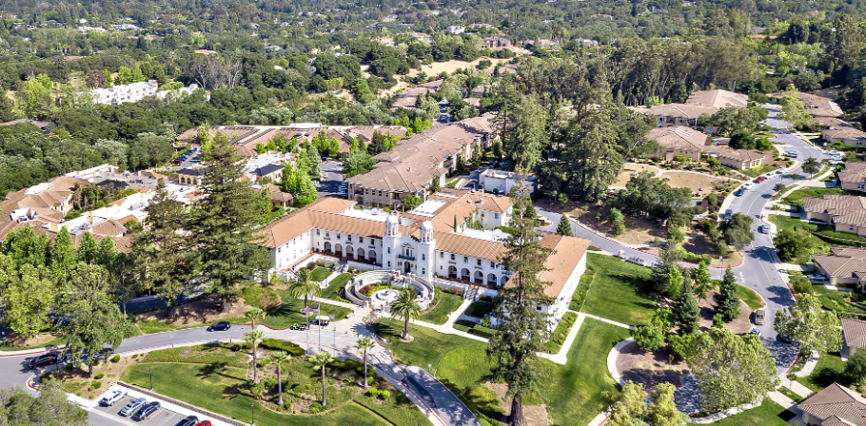
Welcome to our Zoom Meeting!
We’re excited that you’re “here”!

Slide 3

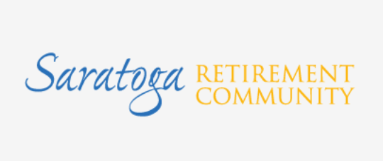
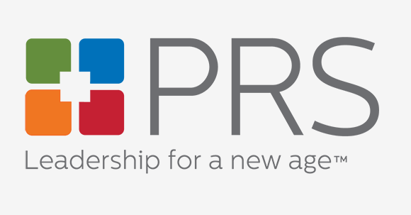
Introductions
*All information is subject to change and current as of 6/25/2025

Slide 4
Welcome! Today’s Agenda:
Welcome and introductions
Project Overview: Renderings, Site Map and Floor Plans
Project Timeline: pre-sales kick-off, development milestones
Tentative fees and other project details
Next steps for all of you!
Frequently Asked Questions and Answers
*All information is subject to change and current as of 6/25/2025

Slide 5
One very important note…
All information shared in the presentation today is tentative and subject to change.
*All information is subject to change and current as of 6/25/2025

Slide 6
Project Overview: Renderings, Site Map and Floor Plans
Three new apartment buildings with 52 new residences
15 unique floor plan styles
  Residence square footage ranges from ~1,200 – ~2,000
  Residence Styles:
    1 Bedroom
    1 Bedroom + Den
    2 Bedroom
    2 Bedroom + Den
    Cottage (1)
  Features include high-quality finishes, premium flooring, etc.
New dining venue and auditorium
Sustainable design: GreenPoint Gold Rated
Enhanced wellness center
*All information is subject to change and current as of 6/25/2025

Slide 7
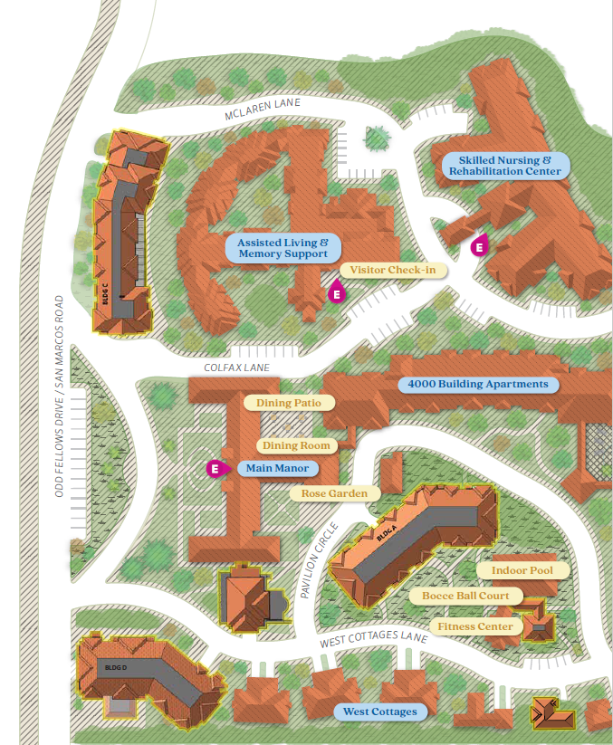
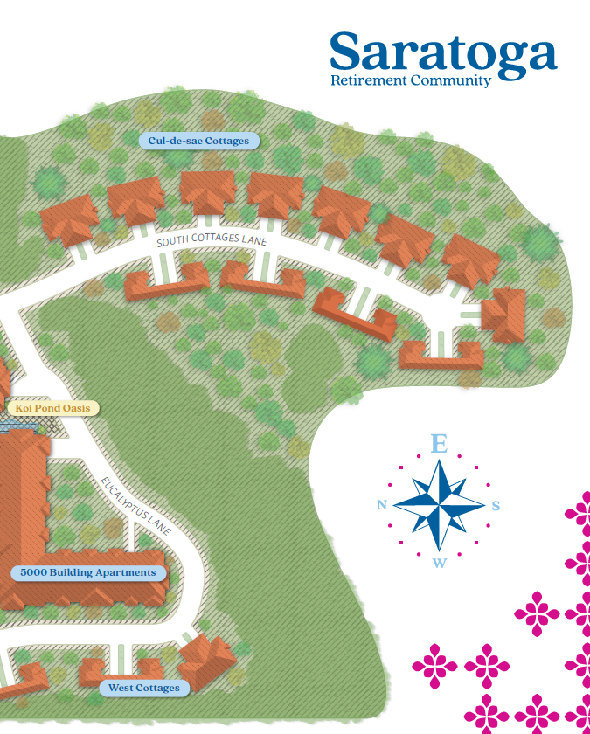
Site Map and Project Overview
*All information is subject to change and current as of 6/25/2025
Oakleaf
(Building C)
Sycamore
(Building D)
Mariposa
(Building A)

Slide 8
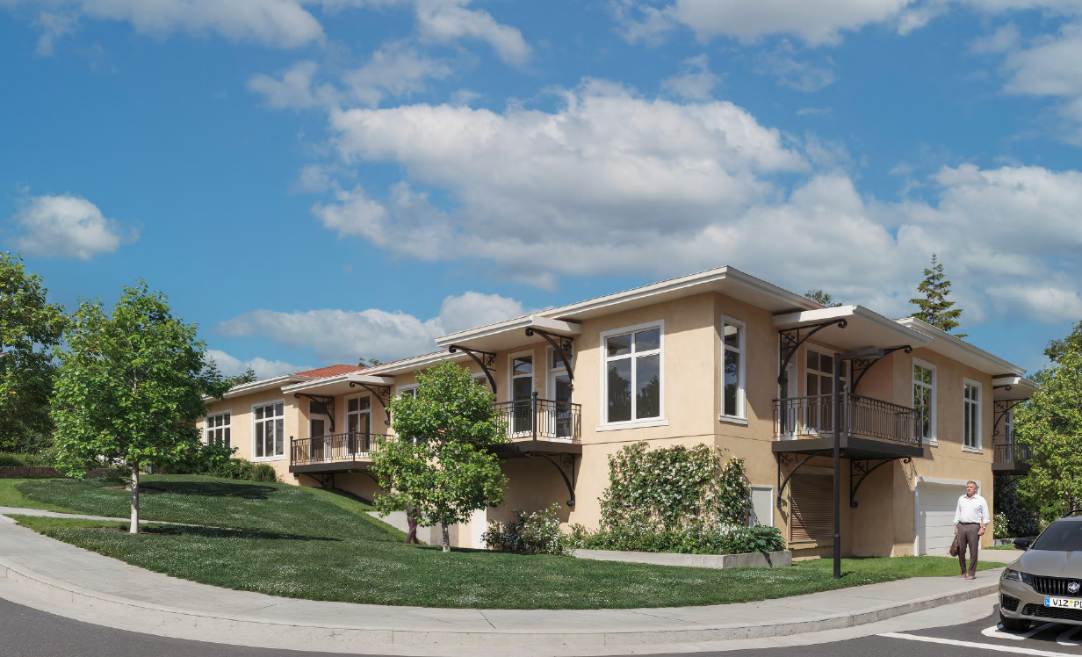
Expansion Building D, South Facing Perspective
Project Renderings
INSERT
*All information is subject to change and current as of 6/25/2025
Notes:
D, Facing south

Slide 9
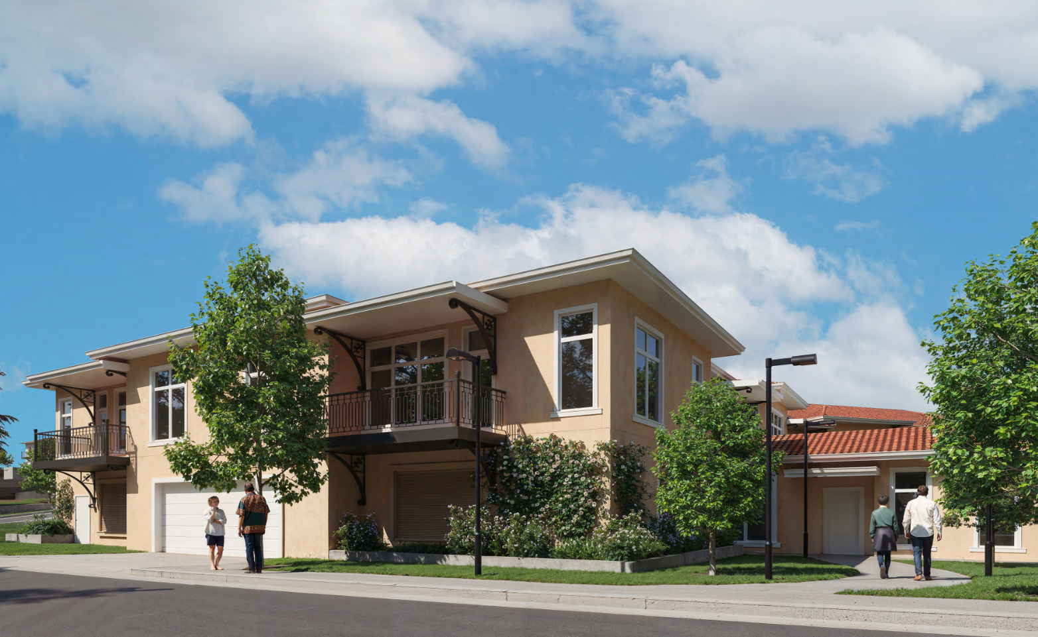
Expansion Building D, South Facing Perspective
*All information is subject to change and current as of 6/25/2025
Notes:
D, South

Slide 10
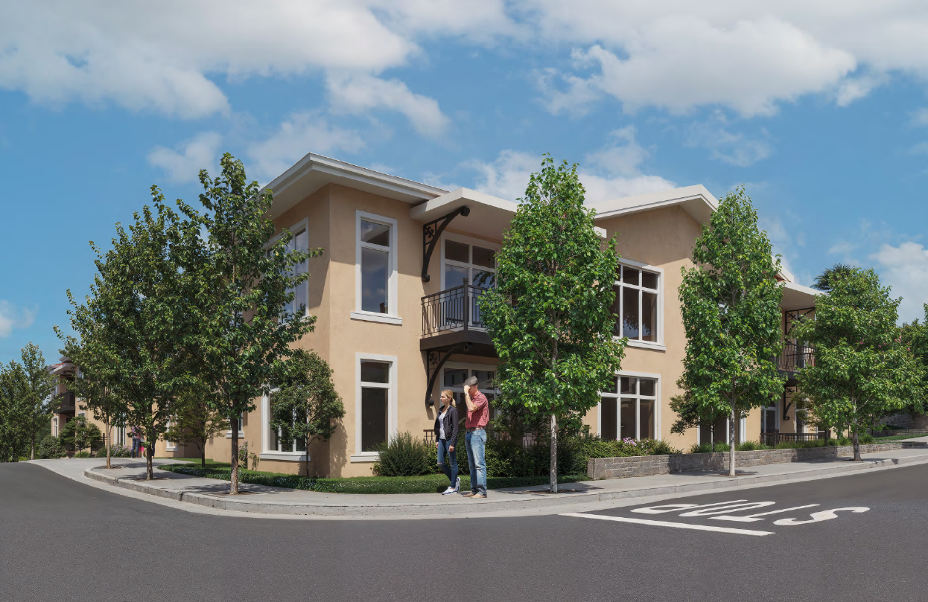
Expansion Building C, East Facing Perspective
*All information is subject to change and current as of 6/25/2025
Notes:
C, East

Slide 11
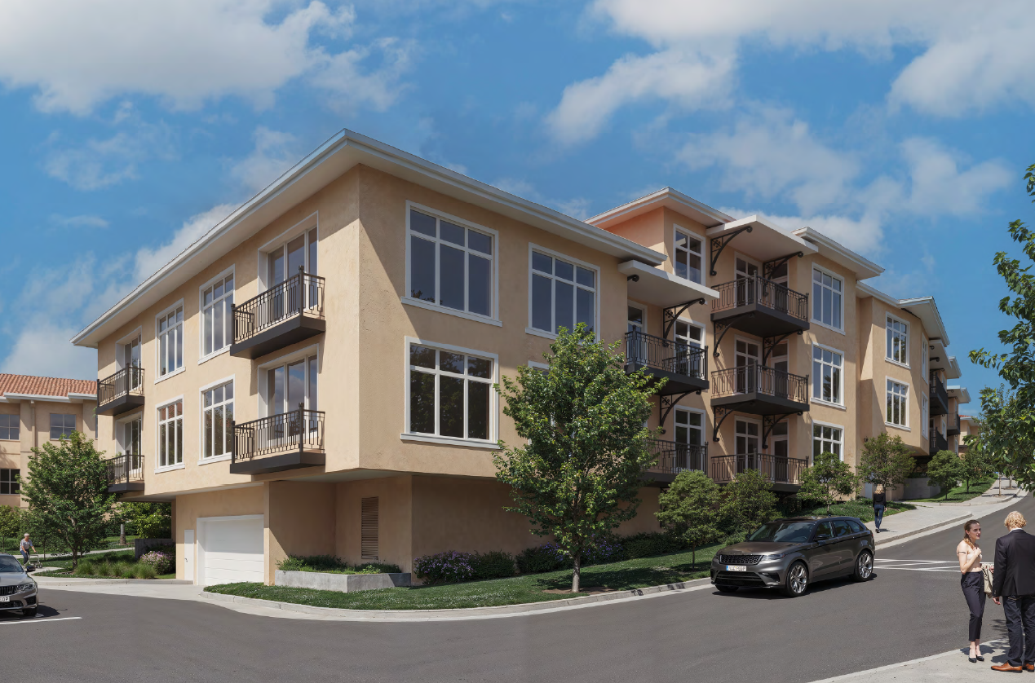
Expansion Building C, Southwest Perspective
*All information is subject to change and current as of 6/25/2025
Notes:
C, SW

Slide 12
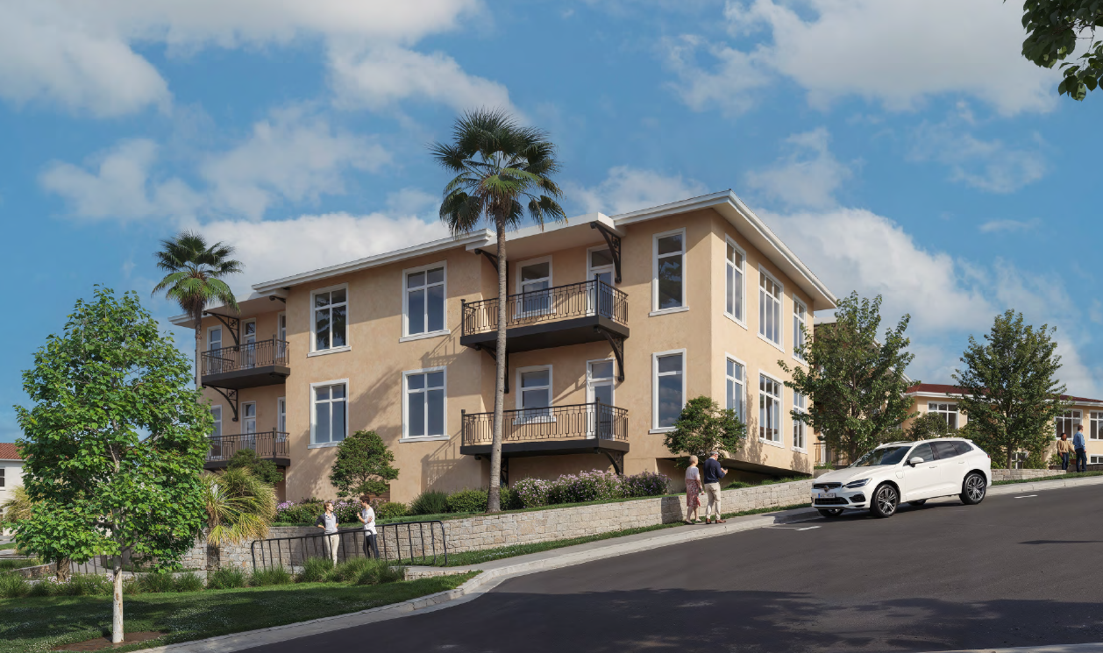
Expansion Building A, Est Facing Perspective
*All information is subject to change and current as of 6/25/2025
Notes:
A, East

Slide 13
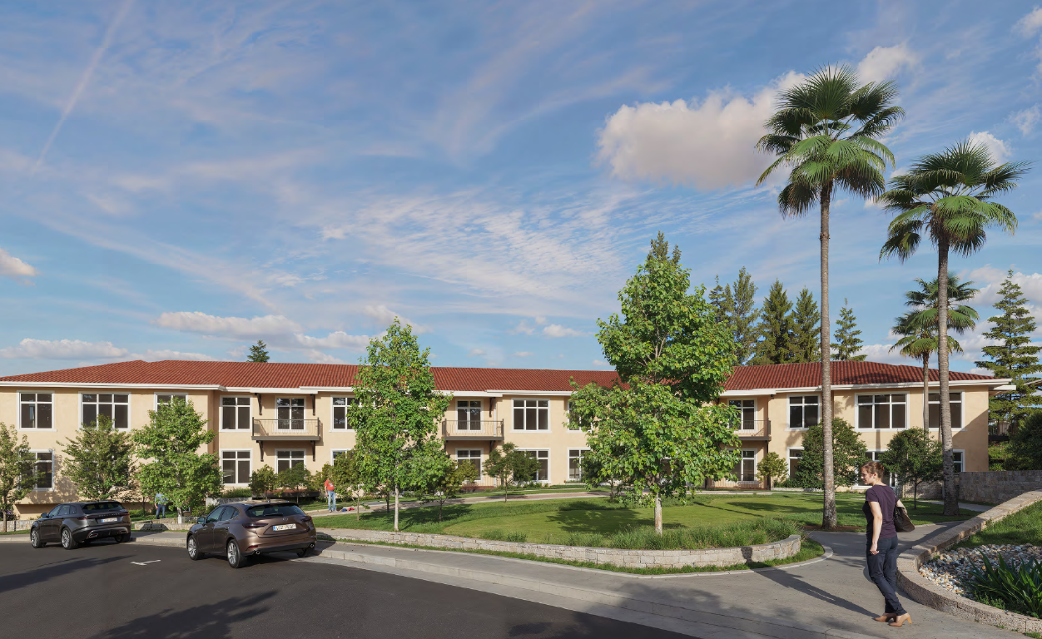
Expansion Building A, North Facing Perspective
*All information is subject to change and current as of 6/25/2025
Notes:
A, North

Slide 14
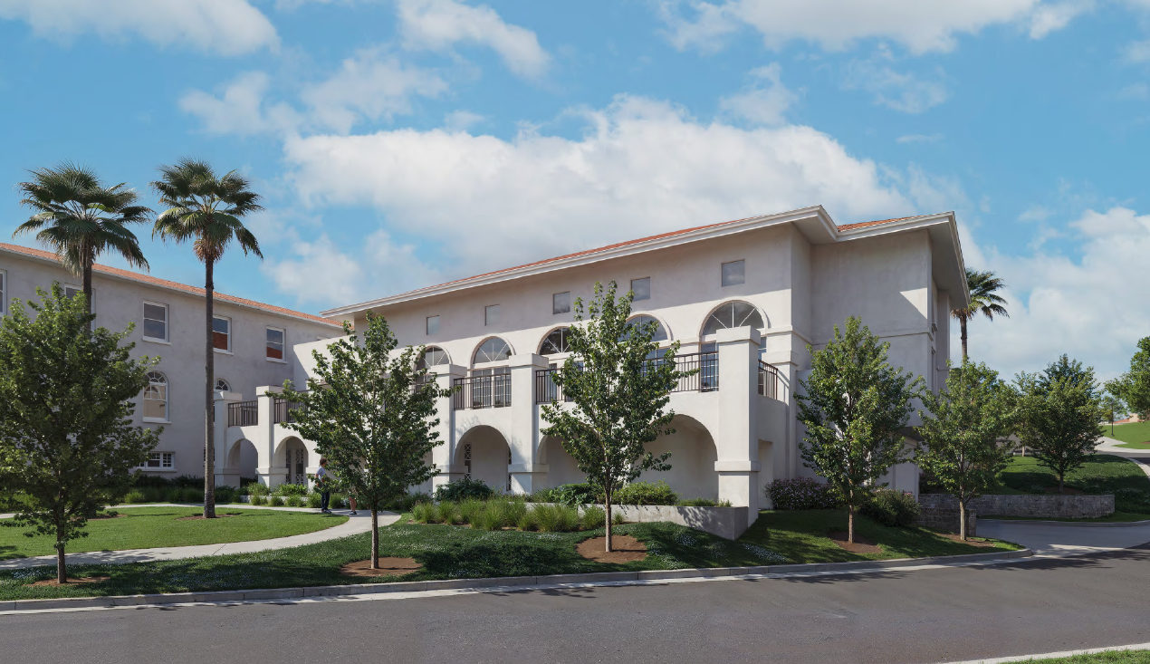
Expansion Auditorium, South Facing Perspective
*All information is subject to change and current as of 6/25/2025
Notes:
Auditorium, S

Slide 15
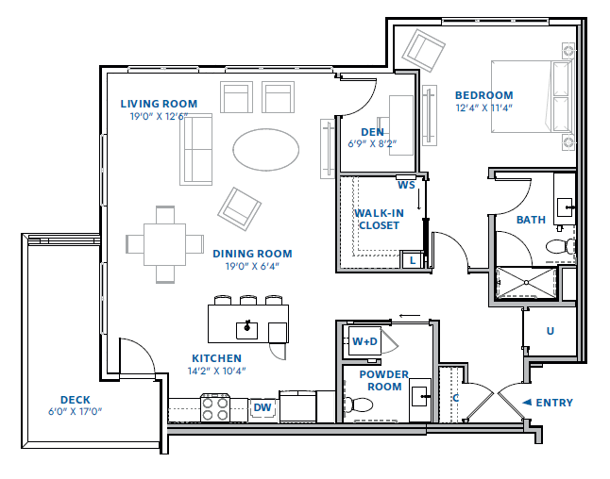
Sample Floor Plans
1,224 Square Feet
110 Square Foot Deck
1 Bedroom
1.5 Baths
Den
Building D Location
*All information is subject to change and current as of 6/25/2025

Slide 16
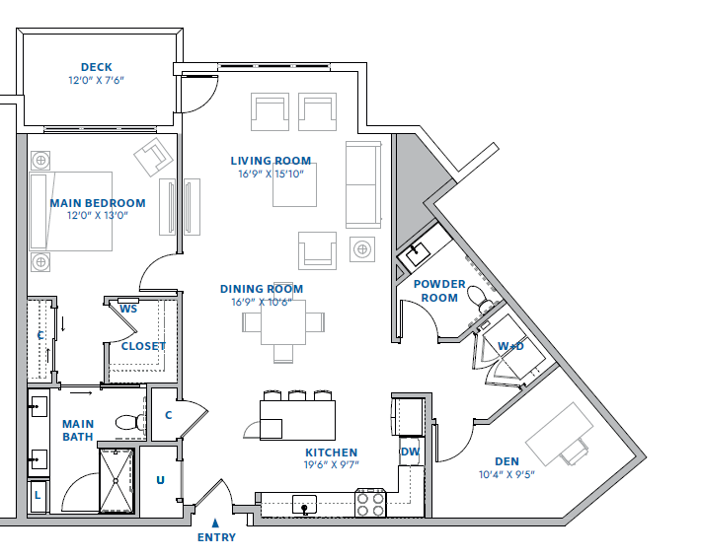
Sample Floor Plans
1,380 Square Feet
90 Square Foot Deck
1 Bedroom
1.5 Baths
Den
Building A Location
*All information is subject to change and current as of 6/25/2025

Slide 17
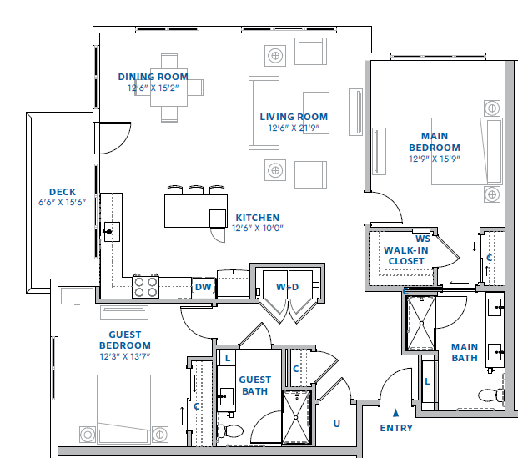
Sample Floor Plans
1,573 Square Feet
90 Square Foot Deck
2 Bedroom
2 Bathrooms
Building A Location
*All information is subject to change and current as of 6/25/2025

Slide 18
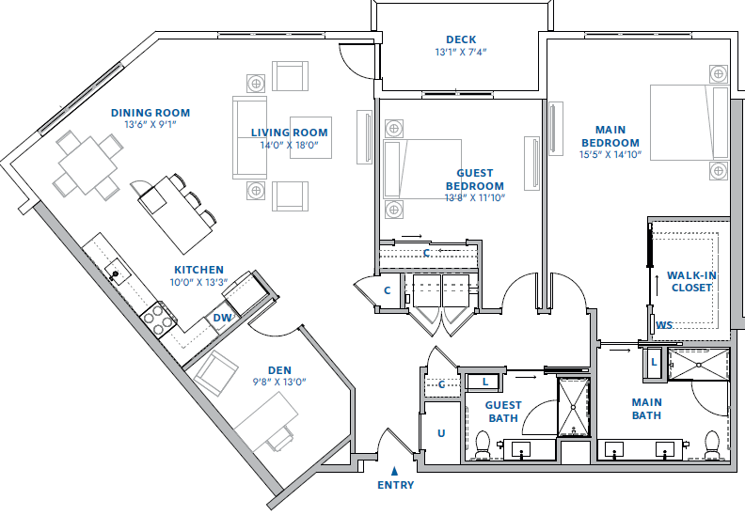
Sample Floor Plans
1,833 Square Feet
96 Square Foot Deck
2 Bedroom
2 Bathrooms
Den
Building A Location
*All information is subject to change and current as of 6/25/2025

Slide 19
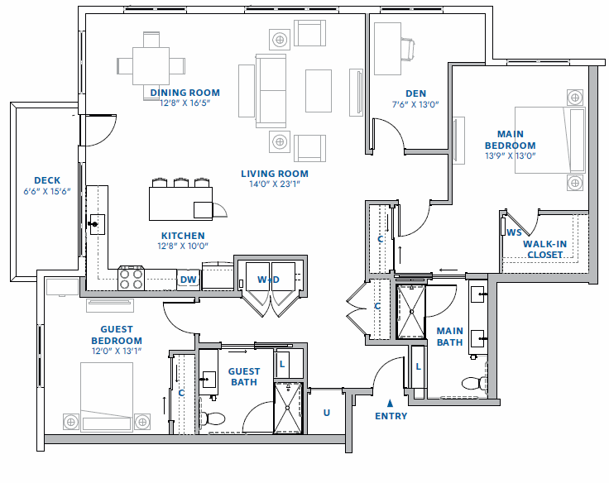
Sample Floor Plans
1,851 Square Feet
90 Square Foot Deck
2 Bedroom
2 Bathrooms
Den
Building A Location
*All information is subject to change and current as of 6/25/2025

Slide 20
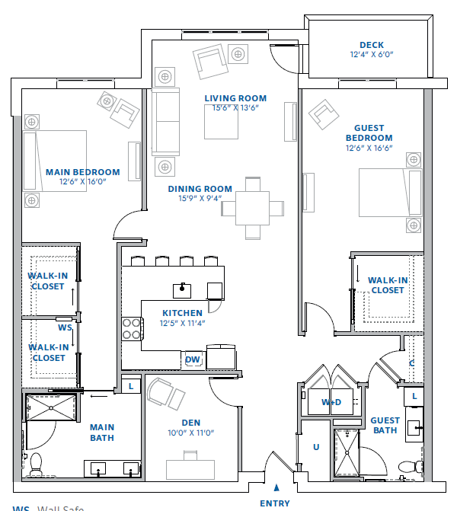
Sample Floor Plans
1,914 Square Feet
74 Square Foot Deck
2 Bedroom
2 Bathrooms
Den
Building C Location
*All information is subject to change and current as of 6/25/2025

Slide 21
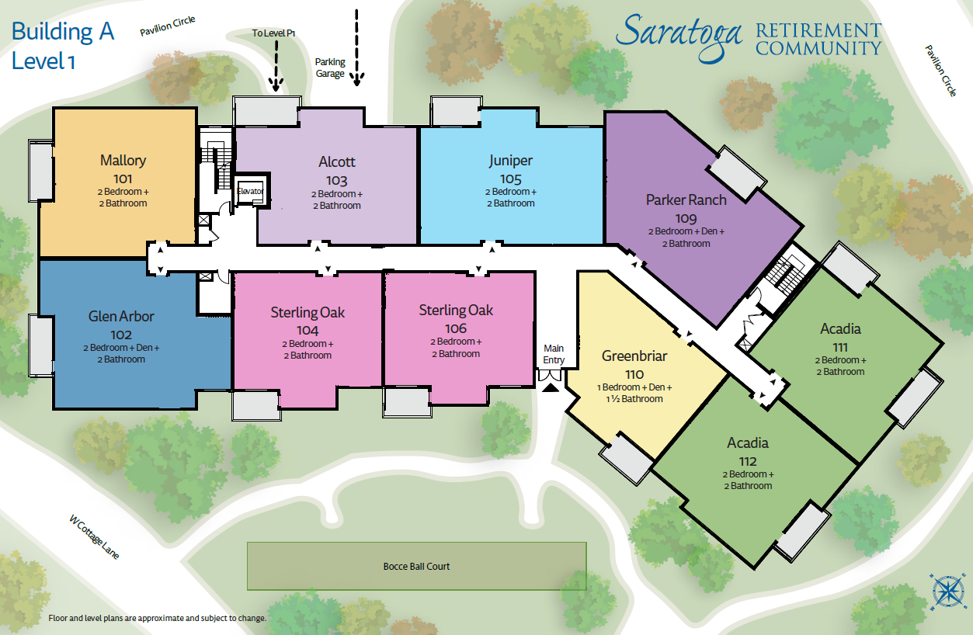
*All information is subject to change and current as of 6/25/2025

Slide 22
Amenities and Services
Garage parking
Packages and mail
Emergency power
Secured Bike storage
Storage Lockers
Electric Vehicle charging
*All information is subject to change and current as of 6/25/2025

Slide 23
Project Timeline and Milestones
Today’s Preview Meeting
Monday, June 30, 2025: Expansion Survey Launch
Monday, August 4, 2025: Presales Kick-off!
Spring/Summer of 2026: Groundbreaking and construction
Summer of 2026: Finish selections process
Grand Opening Spring of 2028
*All times are tentative and subject to change
*All information is subject to change and current as of 6/25/2025

Slide 24
Tentative fees and other project details
Traditional (Non-Refundable) and 80% returnable entrance fees
Monthly fees include the same amenities and services package as existing campus:
  Meals, utilities, housekeeping, wellness programs, social activities, much more
  Fee Ranges
  80% Refundable Entrance Fees: from high $800’s to $2 M+
  Traditional Entrance Fees: mid $600’s to 1M+
  Monthly Fees: from $~7,500 – ~$11,000 (single person) and ~$2,500 (second person)
*All information is subject to change and current as of 6/25/2025

Slide 25
Next Steps for all Wait List Members
Consider the expansion!
Expansion Survey – please complete. The survey will ask, “Based on what you know…”
    Are you interested in the expansion?
    Are you interested in the original campus and not the expansion?
    Are you uncertain, and if so, why?
Update your financial paperwork (if outdated)
You’ll receive a link to the SRC Expansion Resource Hub tomorrow
Schedule your selection appointment (beginning Monday, August 4th)
Select a residence!
*All information is subject to change and current as of 6/25/2025

Slide 26
How to select a residence
Choose your top choice(s) for selection
Sign a Deposit and Reservation Agreement
Place a 10% deposit (see Deposit and Reservation Agreement for refundability terms)
  Interest bearing escrow account
*All information is subject to change and current as of 6/25/2025

Slide 27
Frequently Asked Questions (FAQs)
What does the expansion project consist of?
What is the timeline for the expansion?
How many residences are in the expansion?
What are the square footage ranges?
What are the price ranges?
How does one reserve a residence?
How much is the deposit?
How long do I have to submit my deposit?
What forms of payment do you take for Reservation Deposits?
Is my reservation deposit refundable?
How will I receive updates?
Can I select design features for my residence?
Is my Entrance Fee locked in?
What about monthly service fees?
How long do I have to move in after the expansion opens?
What if I am unable to make my residence selection appointment time and date?
Will the new residences have the same service package as the existing campus?
Can I remain on the Wait List for existing campus homes if I deposit on an expansion residence?
How is priority determined for expansion residences?
Will the expansion be “pet friendly”?
The Saratoga Retirement Community FAQs are as of 6/25/2025 and
subject to change and will be updated as needed. Please see a Saratoga
Retirement Community representative for any questions or concerns.
*All information is subject to change and current as of 6/25/2025

Slide 28
Frequently Asked Questions (FAQs)
What does the expansion project consist of?
What is the timeline for the expansion?
How many residences are in the expansion?
What are the square footage ranges?
What are the price ranges?
How does one reserve a residence?
How much is the deposit?
How long do I have to submit my deposit?
What forms of payment do you take for Reservation Deposits?
Is my reservation deposit refundable?
How will I receive updates?
Can I select design features for my residence?
Is my Entrance Fee locked in?
What about monthly service fees?
How long do I have to move in after the expansion opens?
What if I am unable to make my residence selection appointment time and date?
Will the new residences have the same monthly service package as the existing campus?
Can I remain on the Wait List for existing campus homes if I deposit on an expansion residence?
How is priority determined for expansion residences?
Will the expansion be “pet friendly”?
The Saratoga Retirement Community FAQs are as of 6/25/2025 and
subject to change and will be updated as needed. Please see a Saratoga
Retirement Community representative for any questions or concerns.
*All information is subject to change and current as of 6/25/2025

Slide 29
How long do I have to move in after the expansion opens?
Typically, 60 days from the time that depositors are notified that the expansion is ready for occupancy, but we can be flexible.
*All information is subject to change and current as of 6/25/2025

Slide 30
What if I am unable to make my residence selection appointment time and date?
  We can offer some flexibility by scheduling phone, Zoom, or other virtual appointments. However, we encourage you to meet with us as soon as possible based on your Wait List date. Please keep in mind that we follow a set sales schedule and will need to do our best to adhere to it. If you are travelling in August or September, please let us know your travel schedule and availability.
*All information is subject to change and current as of 6/25/2025

Slide 31
Will the new residences have the same service package as the existing campus?
Yes. The expansion will have the same amenities and services package as the existing campus (meals, housekeeping, wellness programs, social activities, much more)
*All information is subject to change and current as of 6/25/2025

Slide 32
Can I remain on the Wait List for existing campus residences if I deposit on an expansion residence?
Yes. You can remain on the existing campus Waiting List while the expansion is underway. We’d enjoy having a conversation with you about your residence preferences and priorities.
*All information is subject to change and current as of 6/25/2025

Slide 33
Will the expansion be “pet friendly”?
Yes. We say that we’ll be “pet friendly to friendly pets”. There is a pet policy and strict rules to abide by, but we are happy to invite your pets to live with us.
*All information is subject to change and current as of 6/25/2025

Slide 34
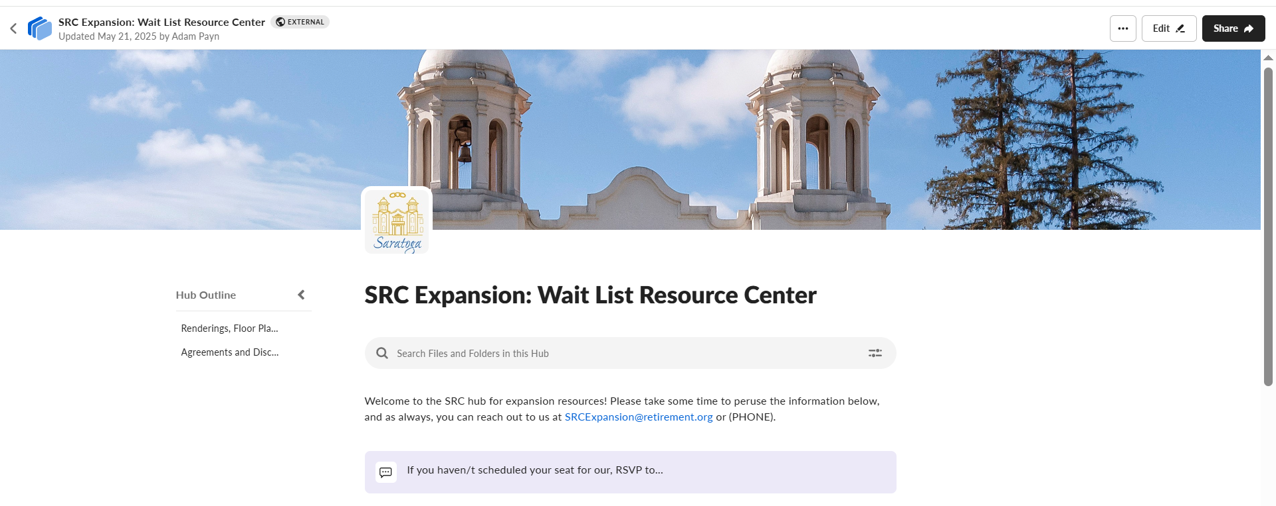
SRC Wait List Member Resource Hub
FAQs, Renderings, Floor Plans and More
*All information is subject to change and current as of 6/25/2025

Slide 35
Next Steps for you!
✓ Consider the expansion!
✓ You’ll receive a link to the SRC Expansion Resource Hub tomorrow morning
✓ Expansion Survey – please complete
The survey will ask, “Based on what you know now…”
  Are you interested in the expansion?
  Are you interested in the original campus and not the expansion?
  Are you uncertain, and if so, why?
✓ Schedule your selection appointment (Beginning Monday, August 4th)
✓ Select a residence
*All information is subject to change and current as of 6/25/2025

Slide 36
Thank you for attending!
*All information is subject to change and current as of 6/25/2025

