Slide 1

Why Gen Z Should Choose a Career In Senior Living
Learn. Innovate. Lead.
Presenter: Lacie Lawless

Slide 2
Why Senior Living?
When most people think of healthcare, they think of hospitals. But what if one of the most meaningful careers is somewhere else?
Build relationships that last
Make a difference every day
Grow into a leadership career

Slide 3
Why Gen Z is the Future of Senior Living
Who is Gen Z?
Born from 1997-2012
Grew up with technology and rapid innovation
Values meaningful work and making a positive impact
Seeks careers with opportunities to grow and lead
Brings fresh perspectives and new ideas to the workplace

Slide 4
What makes Gen Z a Great Fit for Senior Living?
Purpose Driven
Wants a career that makes a difference in peoples lives, not just a paycheck.
Teach Savvy
Comfortable using technology to improve communication, care, and daily operations.
Can help older adults become more comfortable with technology
Innovative
Looks for better ways to do things
Brings creativity to resident activities, employee , therapists, dining staff, and administrators.
Values Diversity and Inclusion
Appreciates different cultures, backgrounds, and life experiences.
Builds meaningful relationships with residents from many walks of life.
Key Takeaway
Gen Z isn’t just entering the workforce they’re bringing the creativity, compassion, and leadership that can help shape the future of senior living.

Slide 5
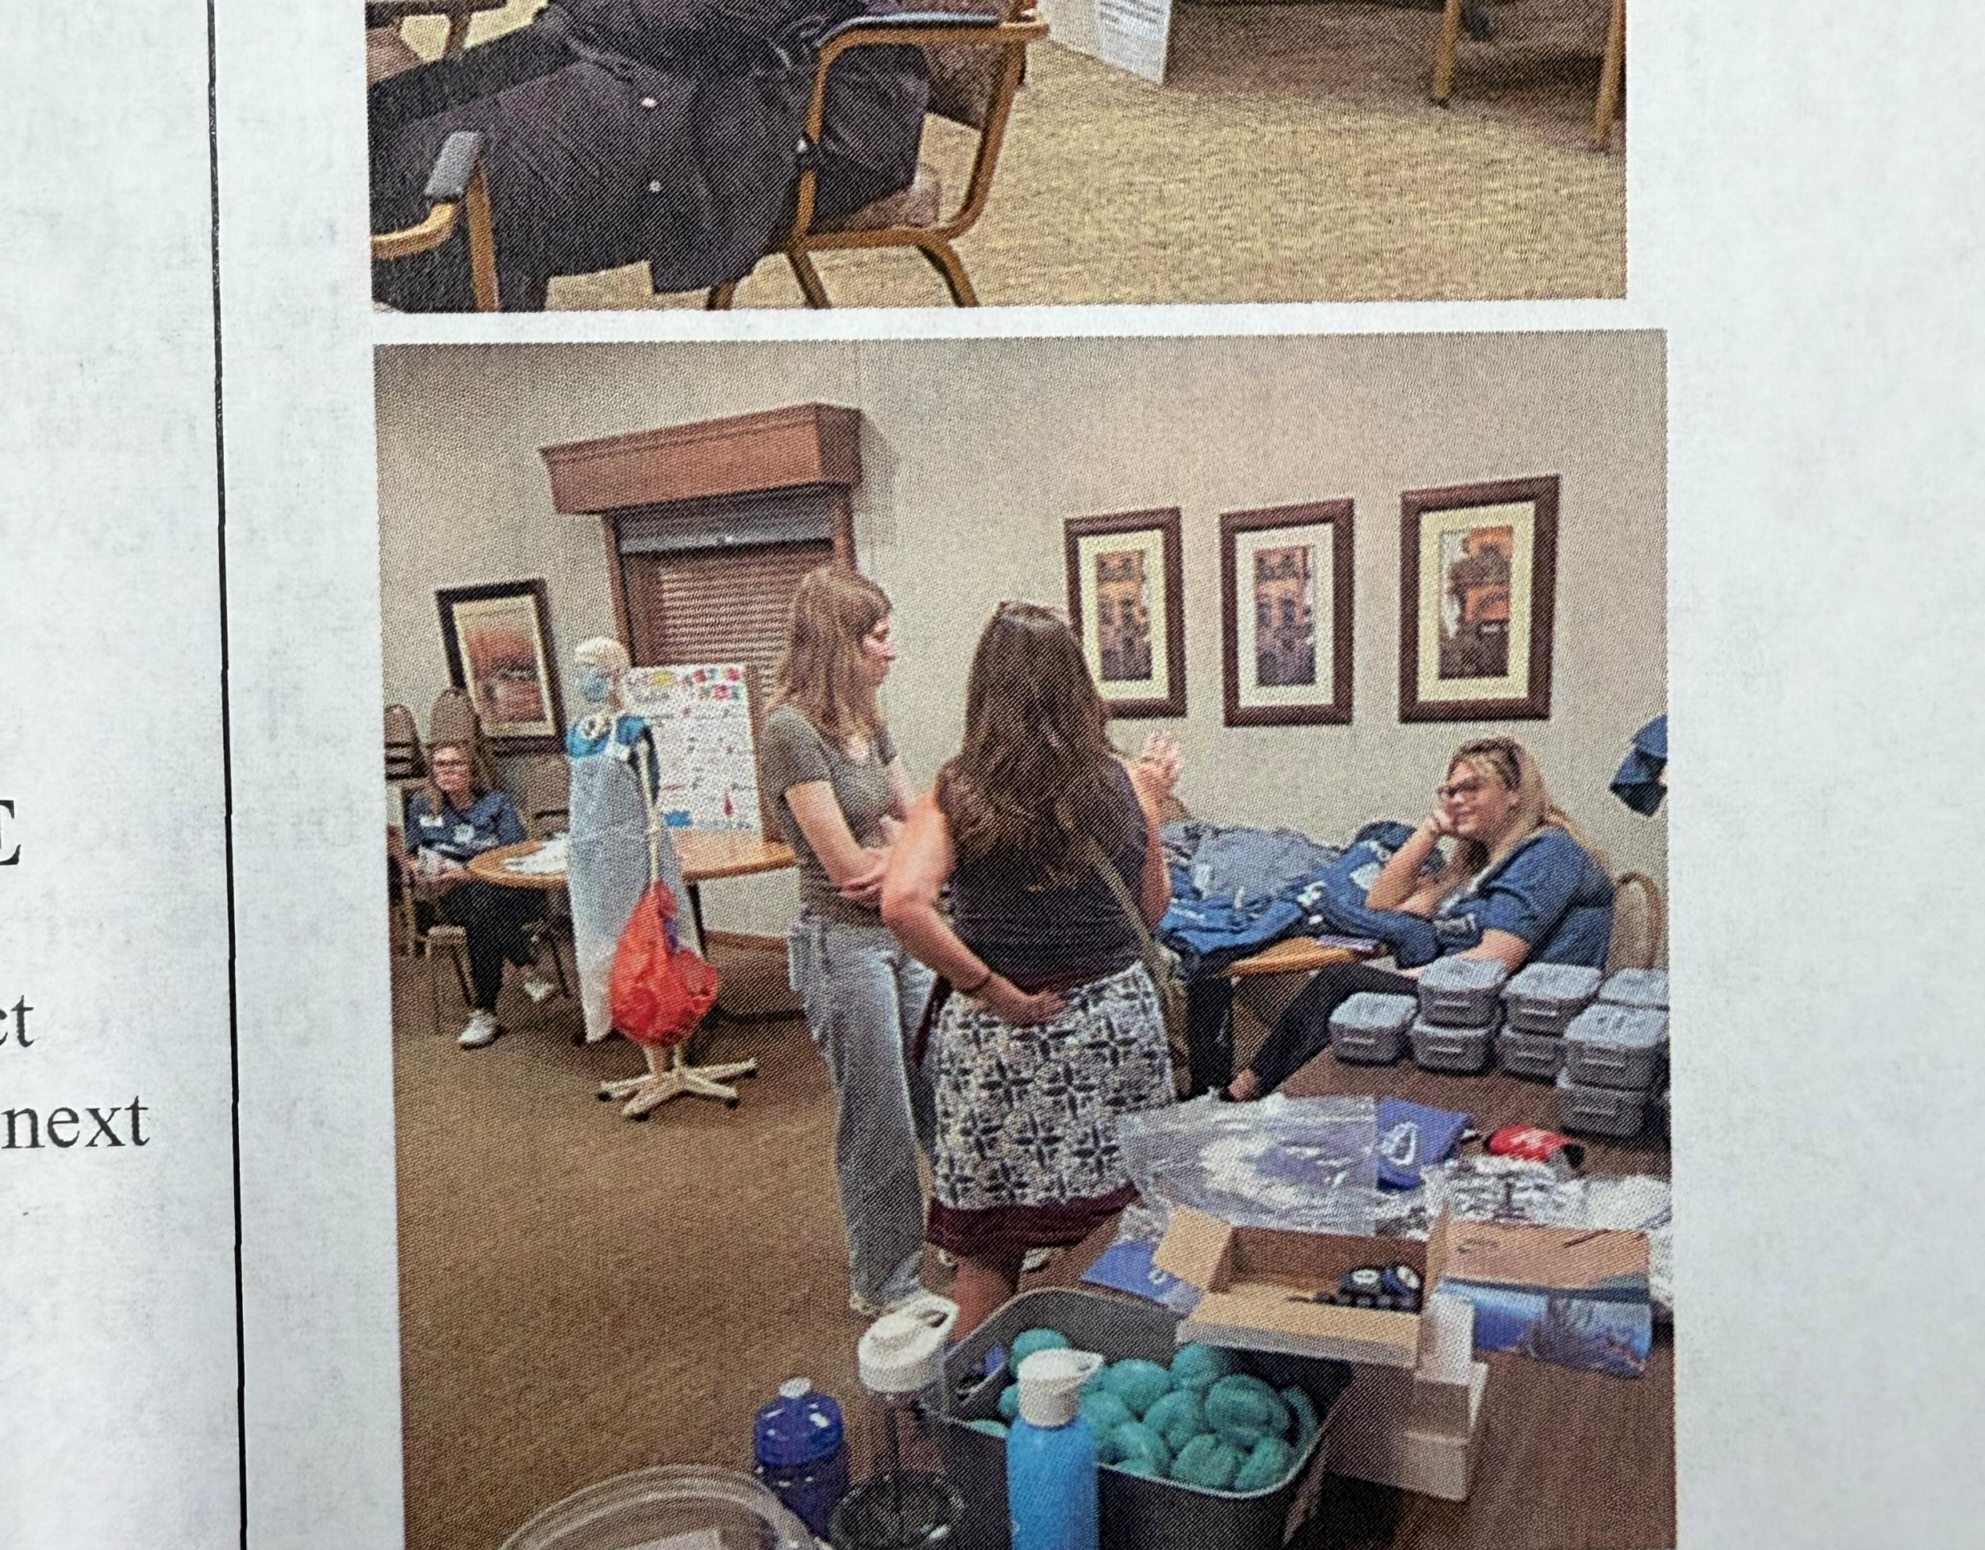
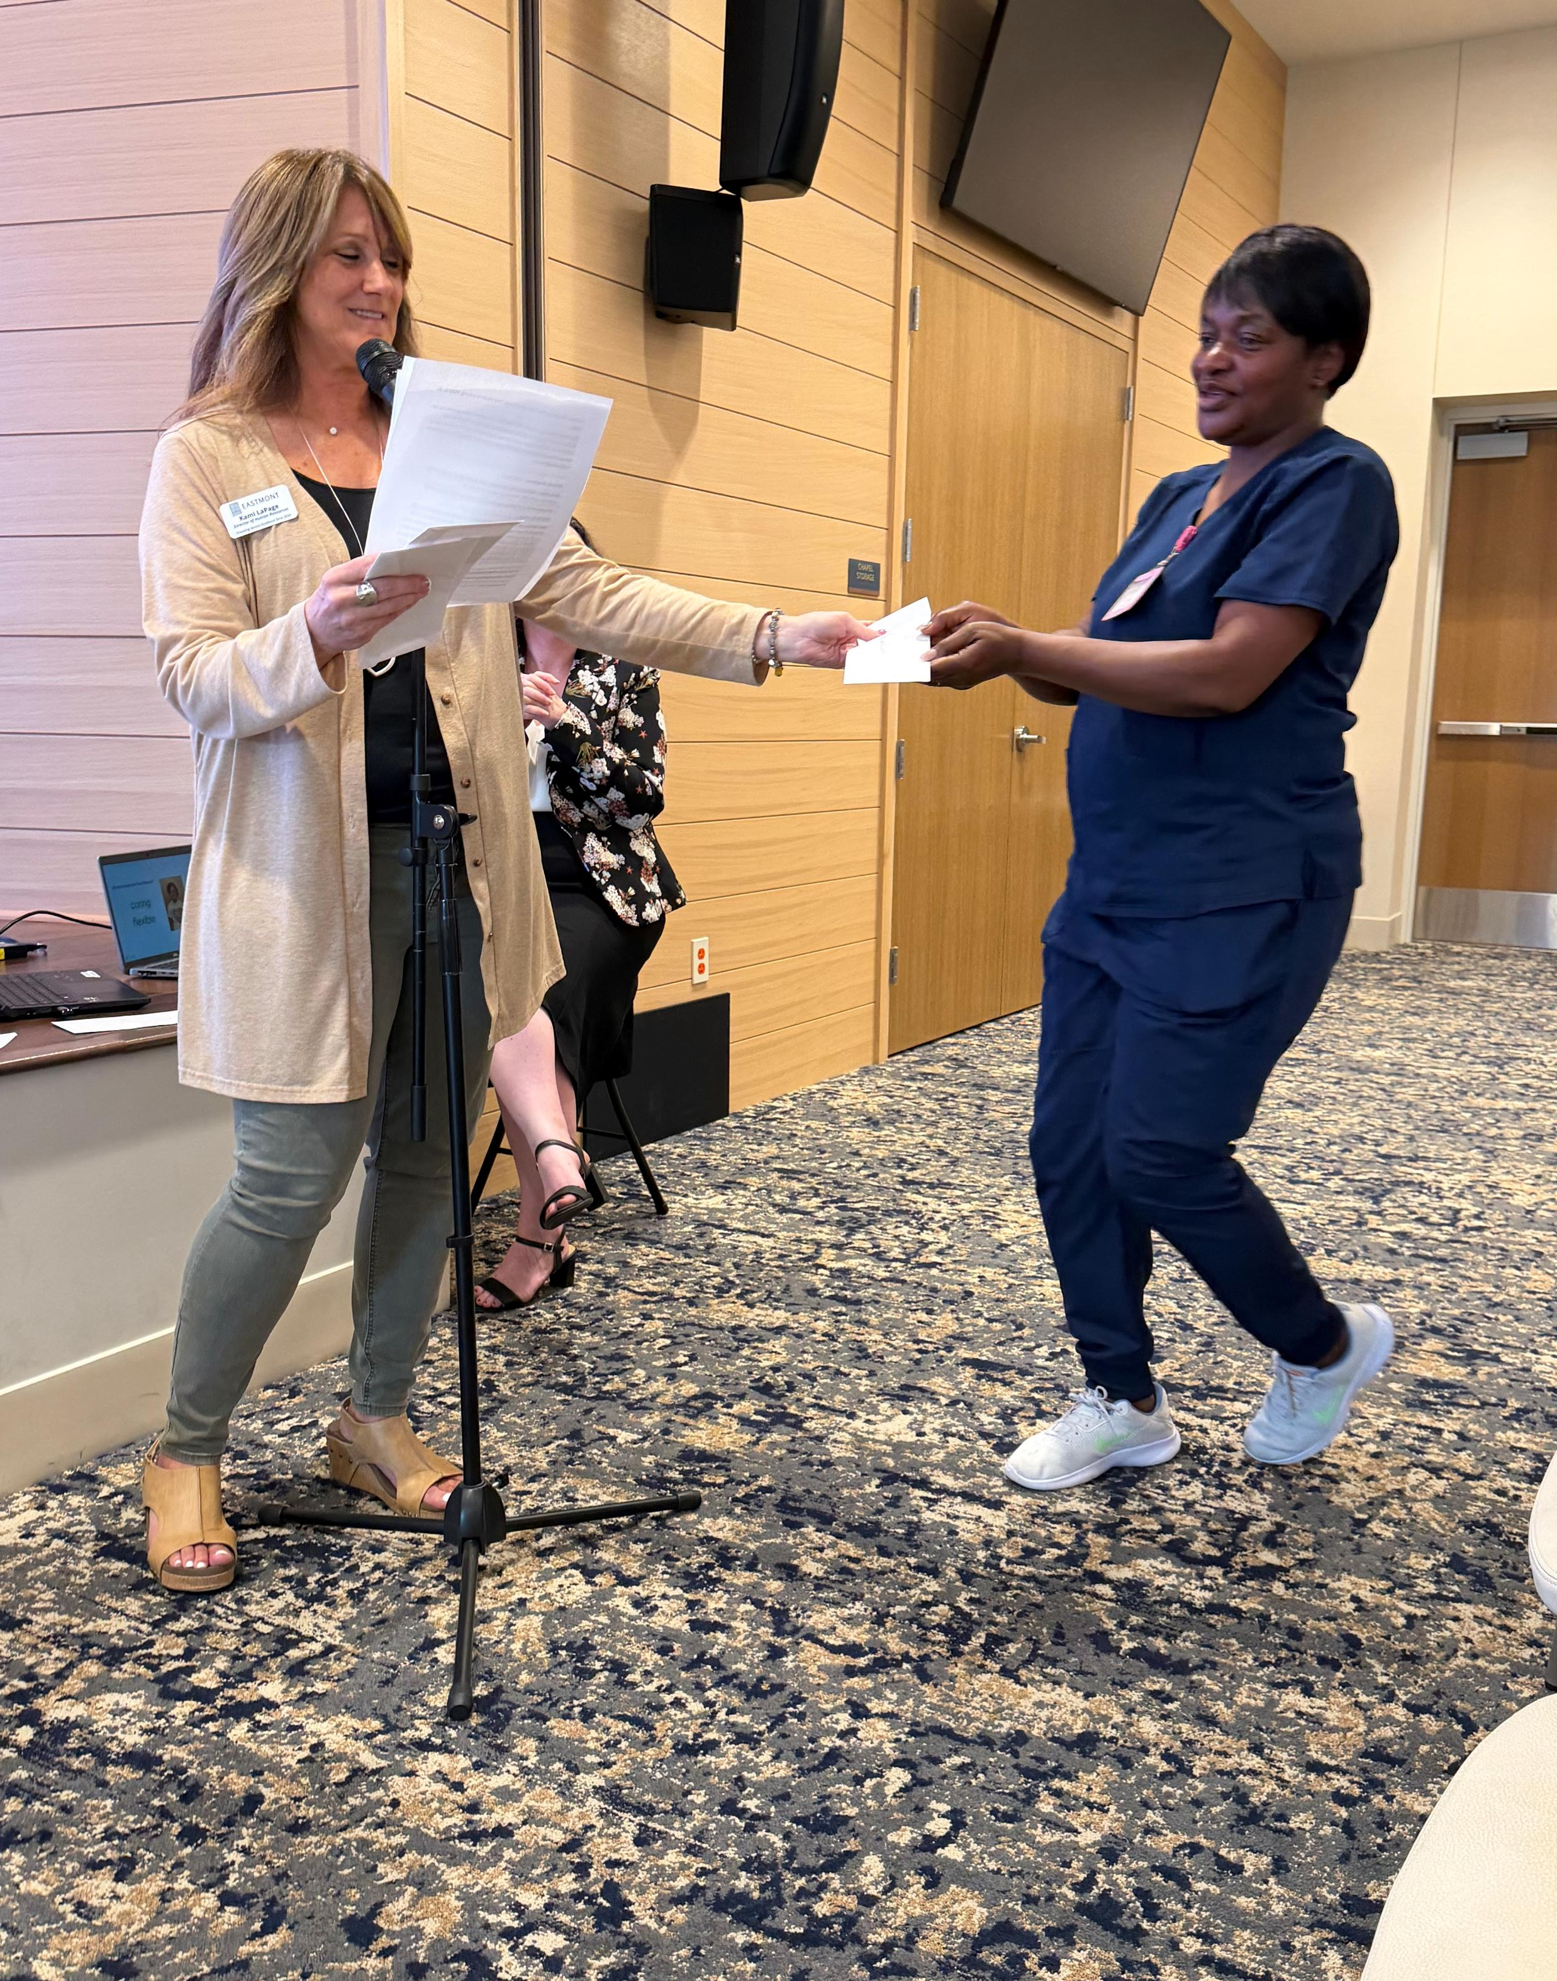
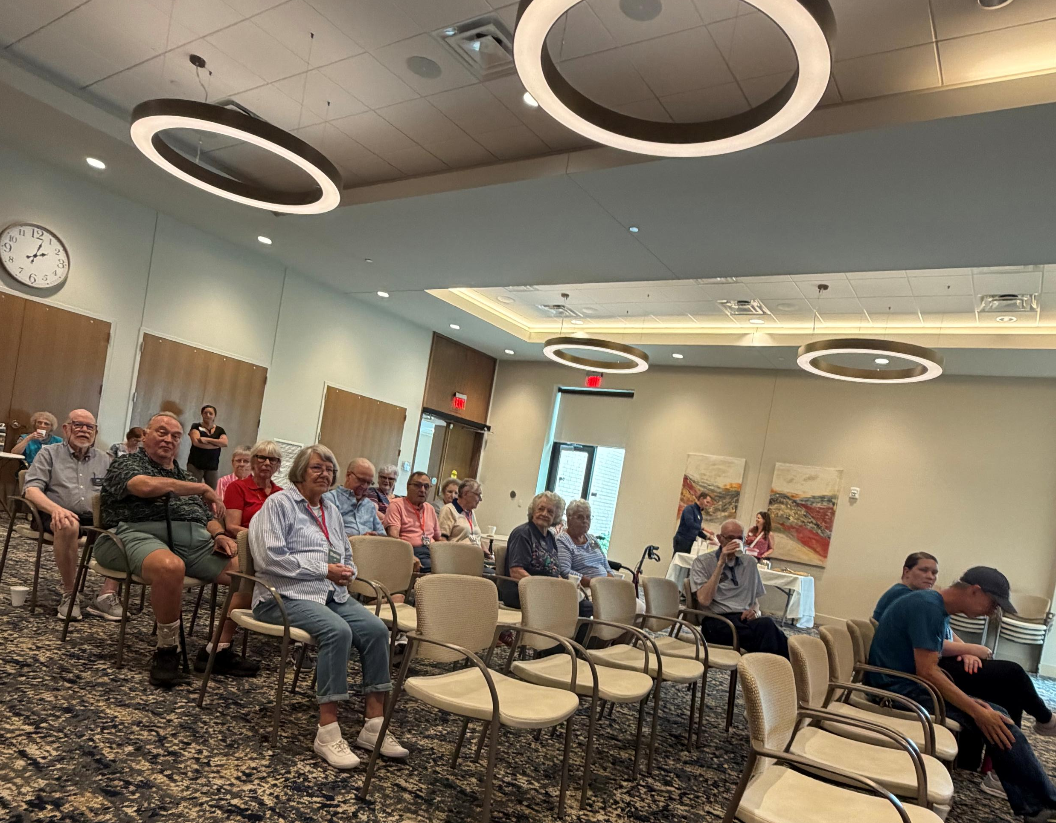
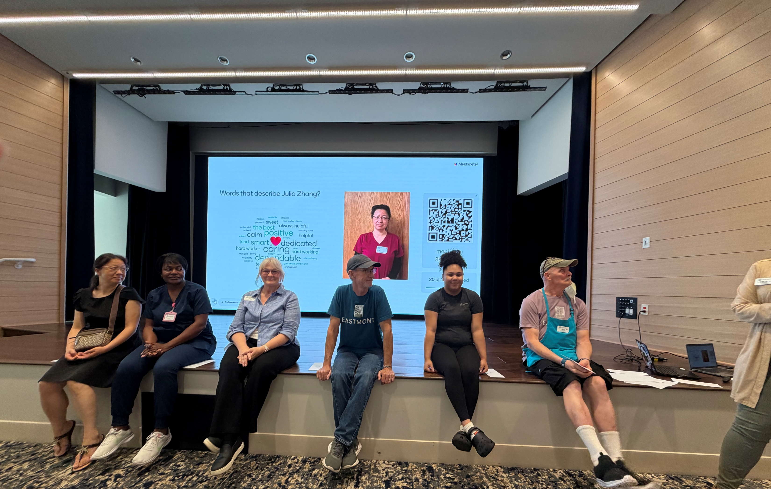
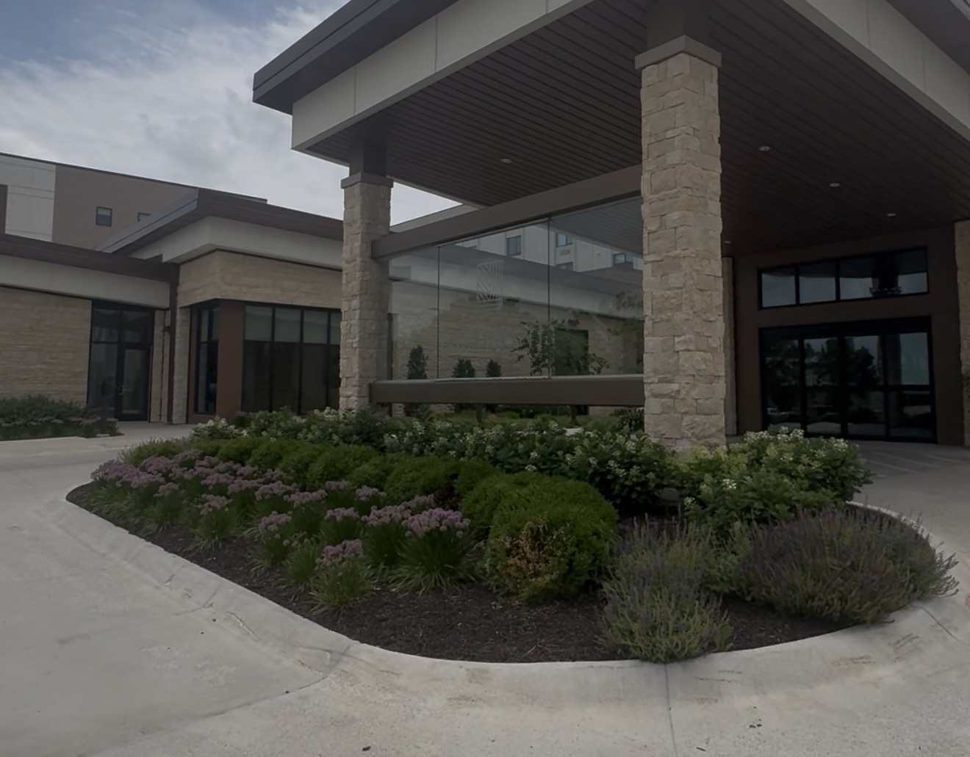
Learn from Experience
Learn from residents' life stories
Learn from healthcare professionals
Gain experience in multiple departments
Build communication and leadership skills.

Slide 6
Bring New Ideas
“innovation isn’t about replacing what works, it's about making a great care place even better”
Gen Z has grown up in a rapidly changing world. We are comfortable with technology, quick to adapt, and eager to improve the way things are done. Senior living needs people who are willing to think differently and create better experiences for residents.
Ways Gen Z Can Innovate
Embrace Technology
Reimagine Resident Engagement
Improve Communication
Build a Positive Workplace Culture
Innovation doesn’t always mean inventing new technology. Sometimes it’s finding a better way to make someone smile, helping a resident reconnects with family, or creating a workplace where employees feel supported and valued. Small improvement can have a big impact on resident's daily lives.

Slide 7
Lead
Your Career Doesn’t Stop at Caregiving
Caregiving
Med Aide
Activities
Sales & Marketing
Human Resources
Nursing
Department Director
Executive Director
Senior Living offers Real opportunities to grow into leadership
Dining

Slide 8
My Experience
Senior Management student
3 years as a caregiver
ROAD intern with Transforming age
Rotated through multiple departments
Career Goal: Administrator
My internship showed me that Senior living isn’t just about caregiving. It’s about leadership, teamwork, business, and improving the lives of residents every day.

Slide 9

The Impact
Working in Senior living means your actions have a direct effect on someone's quality of life. Whether you’re a caregiver, nurse, activity director, administrator, or dining team member, every role contributes to helping residents live with dignity, purpose and joy.
The Impact on Residents
Build meaningful relationships that often feel like family.
Help Residents maintain independence while providing the support they need.
Create moments of joy through conversations, activities and compassionate care.
Be someone residents can trust and depend on every day.

Slide 10
Learn. Innovate. Lead
LEARN
LEARN for those living today
INNOVATE
INNOVATE for those living today.
LEAD
LEAD the future of senior living.

